Slide 1
Beyond Shortest Queue Routing
Esa Hyytiä, Rhonda Righter, Sigurður Gauti Samúelsson University of Iceland
U.C. Berkeley Aalto University
Notes:
Beyond Shortest Queue Routing,
What we study in this paper is the elementary job routing problem with heterogeneous servers and general cost structures.
First, some outline of the talk.

Slide 2
Outline
Problem introduction:
Modelling approach:
Policy iteration & general cost functions:
Numerical examples:
Conclusions:
Notes:
We have our problem introduction, in which we discuss optimality results and our problem set.
Next we have our modelling approach, how we are going to model these systems.
Then we briefly discuss the policy iteration and general cost functions to obtain some near optimal results.
Finally we have numerical examples, don’t worry we won’t go into detail.

Slide 3
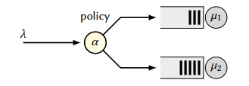
Introduction
Routing jobs to parallel servers is a common and important task in today’s computer systems
Join-shortest-queue (JSQ) routing minimizes the mean response time when the servers are identical and service times are independent and exponentially distributed
Apart from that, only a few optimality results exist, due to complexities from the infinite state space
Notes:
So, the introduction.
Routing jobs to parallel servers is a common and important task in todays computer systems.
(point to image) This shows a simple system with an arriving process with rate lambda, some dispatcher using a policy alpha, and two servers with queues and a service rate mui1, and mui2.
Join-shortest-queue routing or JSQ for short, minimizes the mean response time when the servers are identical and service times are independent and exponentially distributed.
Apart from that, only a few optimality results exist, due to complexities from the infinite state space.

Slide 4
Our problem
We do not know the size of the jobs
Job inter-arrival times and service times are exponentially distributed
State information is the number of jobs at each server
For clarity, we consider two heterogeneous parallel servers subject to a large class of cost structures, e.g., by
c(w) = cost when job waits time w
Modelling approach generalizes straightforwardly to K > 2 servers
Notes:
Then we have our problem:
We don’t know the size of the jobs, and the job inter-arrival times and service times are exponentially distributed.
Our state information is the number of jobs at each server.
For clarity, we consider only two heterogeneous parallel servers, that are subject to a large class of cost structures, e.g. by
(look at and show the formula)
Though, the modelling approach generalizes straightforwardly to K > 2 servers.

Slide 5
Heterogeneous servers
JSQ has been shown to be optimal in some specific cases, but, this is no longer the case, e.g., when service rates are unequal
SED (Shortest expected delay) is also not optimal with heterogeneous servers, even with exponential assumptions
Notes:
JSQ has been shown to be optimal in some specific cases , but this is no longer the case, e.g., when service rates are unequal.
SED, or shortest expected delay, is a policy that routes a job to the server that has the least work left, or the shortest amount of work left.
SED is also not optimal when we have heterogeneous servers, even with exponential assumptions.
So now I want to briefly mention the state of our system

Slide 6
State of our system
The state of our system is (n,m), where n denotes the number of jobs in server 1, and m is the number of jobs in server 2
With exponential assumptions
State x = (n,m)
Fixed routing policy; standard markov process
Otherwise; standard MDP
Notes:
The state of our system is (n,m), where n denotes the number of jobs in server 1, and m is the number of jobs in server 2.
With exponential assumptions
State x=(n,m)
Fixed routing policy, we have a Standard markov process
Otherwise we have a standard Markov decision process

Slide 7
Infinity is not good
Ok, so infinite state space is a problem…
… what can we do …. LET´S GET RID OF IT!
First idea: truncate the state space?
Introduces bias, especially when the load is moderate or high …
Notes:
So the infinite state space is a problem..
What can we do? Lets get rid of it.
First idea: truncate the state space? Introduces bias, especially when the load is moderate of high..
Next we will talk about our Modelling..

Slide 8
Modelling
Our approach:
Model the system accurately where decisions matter the most
States with a small number of jobs
Rely on appropriate approximations elsewhere
State-space aggregation
This enables us to
Analyze the system (with given routing policy) and
Compute the (near) optimal routing policy
Notes:
Look at slides for information when talking.

Slide 9
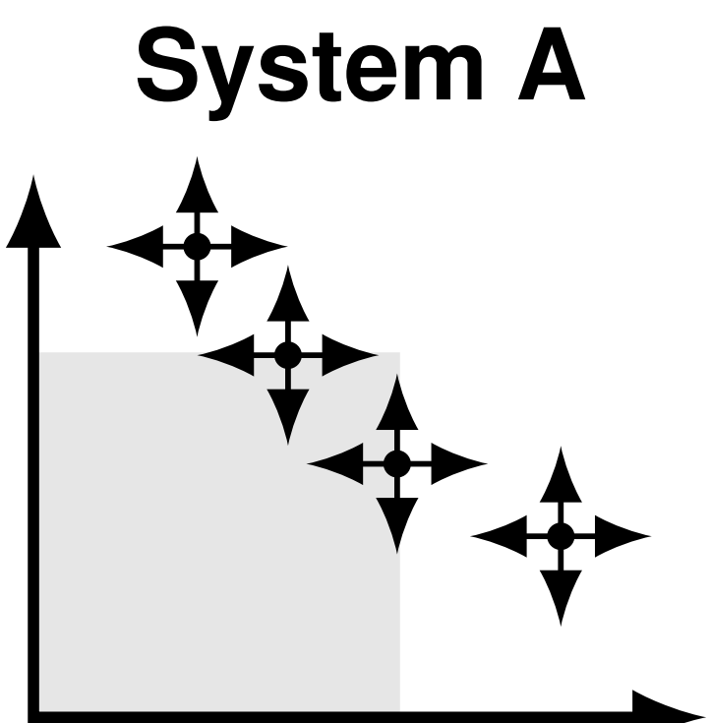
Original system
Simple system, jobs arrive according to Poisson process and service time exponentially distributed
Servers are heterogeneous and we have a number-aware setting in where state n = (i,j) server 1 has i job’s, and server 2 has j job’s
Finding the optimal policy is surprisingly difficult due to the infinite state space
Notes:
Our original system:
This is a two dimensional MDP.
Simple system, jobs arrive according to a Poisson process, and service times are exponentially distributed.
The servers are heterogeneous and we have a number-aware setting in where state n = (i, j) denotes that server 1 has i jobs, and server 2 has j jobs.
Even though it is elementary, finding the optimal routing policy is a surprisingly difficult problem due to infinite state space.
Except when the service rates are equal of course and the objective is response time minimization. (Then we use JSQ for example)

Slide 10
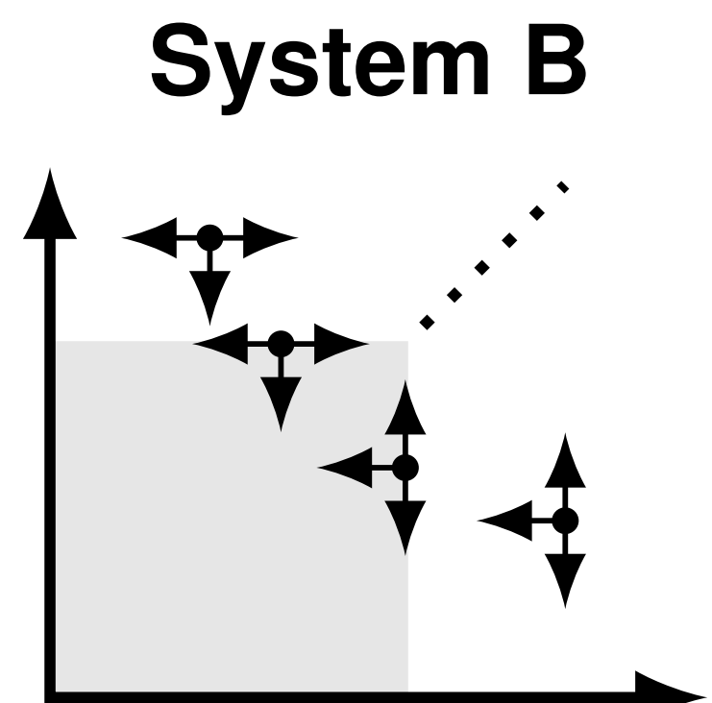
Fixed policy
Now we modify the system
Routing is most crucial when servers have only a few jobs
Define a region A which contains a finite number of states near the origin
A = { (i, j) | i < n, j < m}, where n and m are free variables
Elsewhere, a default policy kicks in
Notes:
Now we modify the system, one step at a time.
Routing decisions tend to be most crucial when servers have only a few jobs, so we define a region A, which contains a finite number of states near the origin.
(show how A is formulated, look at slides)
Hence, at this point we have simply fixed the routing decision in states where we believe that SED or similar policy is near optimal.
I.e. ‘when there is an abundance of jobs, keep all servers busy’

Slide 11
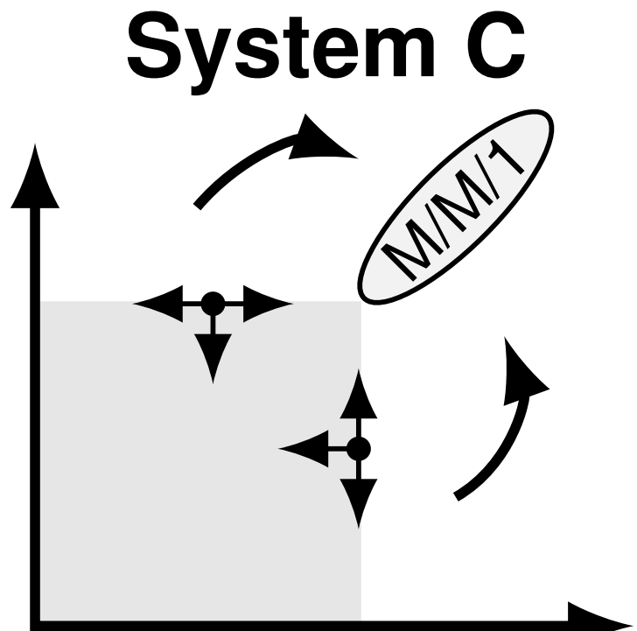
State space collapse/aggregation
When i,j >> 0, the system tends to stay near the diagonal line i ~ j
State-space collapse occurs beyond A
States beyond A “collapse” to M/M/1
Service rate are combined
Visit outside A = mini-busy period in M/M/1
Equivalently, we allow jockeying
Notes:
When the number of jobs in each server is way higher than 0, the system tends to stay near the diagonal line i ~ j.
Hence, we assume a state-space collapse occurs beyond A
States beyond this critical region A collapse and reduce to a standard M/M/1 Queue.
In this M/M/1 queue, service rates are combined, any visit outside critical region A causes a mini-busy period in M/M/1.
This is equivalent to allow jockeying (e.g. jobs are allowed to jump between queues)

Slide 12
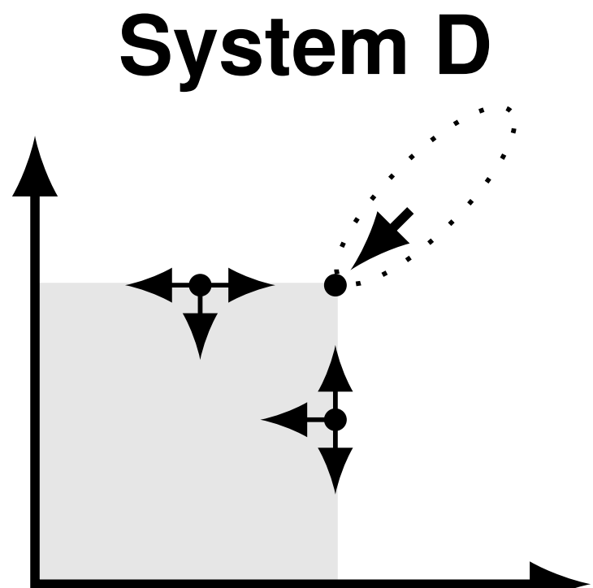
Combined super state
Mini-busy period of M/M/1 can be analyzed
Aggregate M/M/1 to a new super state z
With equal mean sojourn time
With equal mean costs
Routing was fixed outside A, and thus Systems C and D are equivalent!
Notes:
Now for the final modification.
The combined super state.
This mini-busy period of M/M/1 queue can be analyzed.
We aggregate the M/M/1 queue to a new super state called z
(Show on slide) This super state is the corner state of the critical region.
We have fixed routing outside A, and this systems C and D are equivalent.

Slide 13
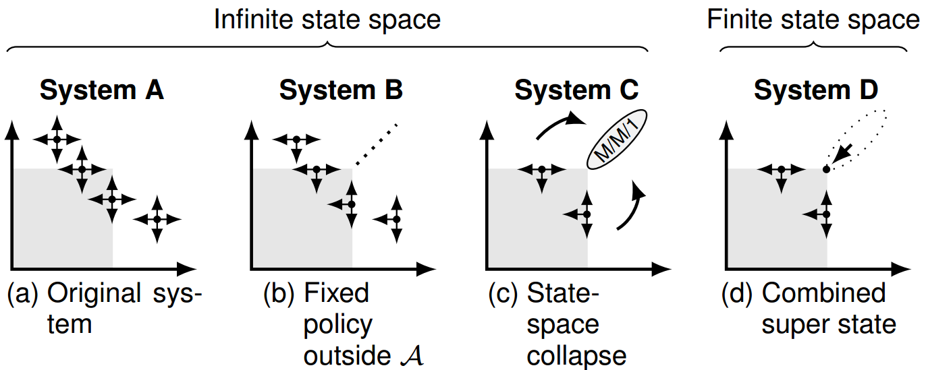
Our modelling systems
Notes:
Again, brief look at our states.

Slide 14
General cost function
Our approach allows for other performance metrics besides response time
For example, we may incur a unit cost if an arriving job sees more than two jobs ahead of itself upon arrival. This reflects how people tend to feel about queueing
Notes:
Now, lets talk about the general cost function.
Our approach allows for other performance metrics besides response time.
For example, we may incur a unit cost if an arriving job sees more than two jobs ahead of itself upon arrival.
This can reflect how people tend to feel about queueing.

Slide 15
General case with K servers
Fairly straightforward to extend to k > 2 servers
Problem is; by adding 1 server we are adding a whole new dimension to our problem
For small k, this approach seems feasible
For large k, scalability becomes an issue and the objective changes: routing is about finding an idle or sleeping server
This is a different problem
Notes:
We have been talking about two dimensional systems, only having 2 servers.
That was for clarity and simplicity, but it is fairly straightforward to extend to more than 2 servers.
Problem is; by adding a server, we are adding a whole new dimension to our problem.
For small k, this approach seems feasible.
For large k, scalability becomes an issue and the objective changes: routing is now about finding an idle or sleeping server.
This is a different problem.

Slide 16
What can we do?
Can analyze any fixed policy
Develop better routing policies
Notes:
What can we do with our system? We can use it to analyze any fixed policy, the second thing is that we can use it to develop better routing policies.
…
.

Slide 17
Evaluating the approximation
Now we apply our approximation to estimate the mean response time with JSQ and SED
This validates the use of our system D and yields a sequence of increasingly more accurate estimates for the mean response time
Notes:
Now we need to apply our approximation to estimate the mean response time with join shortest queue and shortest expected delay.
This validates the use of our system D and yields a sequence of increasingly more accurate estimates for the mean response time.

Slide 18
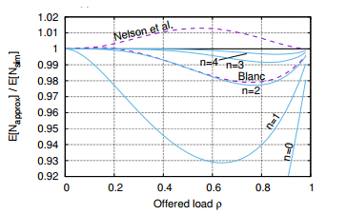
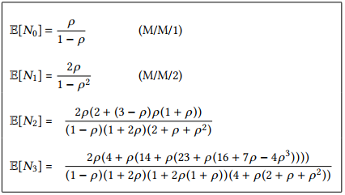
Two identical servers with JSQ
E[N] denotes the size of the square region A
Notes:
Let E[N] denote the size of the square region A, so an N by N box.
Table on the left are the first 4 estimates generated by straightforward analysis of system D.
This is a new closed-form approximation to a classic problem
So first when the box is 0,0.
Then we have 1,1 e.t.c.
…
The first is an M/M/1 queue, and when n=1 the servers reduce to M/M/K system.
The figure on the right shows the ratio of the estimate of E[N] to the simulated value for n = 0, .., 4
The Y axis denotes the ratio of accuracy, while X axis denotes the load of the system.
It quickly becomes quite accurate, thus supporting the assumption that system D servers as a reasonably good model for the original system, when n is sufficiently large.

Slide 19
Near optimal routing
Sometimes it is convenient to assume that each customer incurs a cost upon arrival
For example, c(n) = (n+1)/(m mu) = mean response time of the new job
Equivalent cost rate r(n)=n
MDP with a finite state space
Value / policy iteration yields the optimal policy!
Notes:
To make routing decisions, its convenient to think of cost incurred, e.g. customer arriving.
Therefore we define c(n) as the admission cost function, which is the immediate cost of adding a job to server K that currently has j jobs. This can vary depending on service rate.
Now we have reduced the infinite state space of the original system to a finite number of states and well-defined cost rates in each state.
Now we can solve the near optimal policy via value iteration.
We can repeat this value iteration until it converges, which it does rapidly.

Slide 20
Numerical observations:
With example systems:
Numerical evidence on how quickly policy iteration converges
First policy iteration round yields the largest improvement
Notes:
We have some numerical observations, which I will not go into detail here but
With our example systems we find:
Numerical evidence on how quickly policy iteration converges and that
The first policy iteration round yields the largest performance improvement.

Slide 21
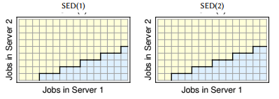
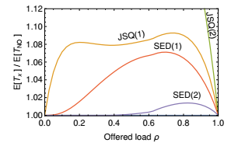
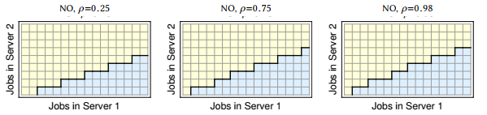
Numerical example:
A closer look at SED and NO
System:
Service rates (3,1)
Minimize mean response time
Notes:
We have multiple numerical examples in the paper, but we are going to take a look at one.
Lets take a closer look at when SED and NO make different decisions.
Remember that SED stands for shortest expected delay, and NO is near optimal, which we get from running value/policy iteration.
NO is the optimal policy for system D, and assume its near optimal for the original system.
Service rates are (3,1), that is server 1 has service rate of 3 and server 2 has service rate of 1, meaning server 1 is 3 times as fast as server 2.
The objective is to minimize the mean response time.
We have in the top right, two graphs marked SED(1) and SED(2).
These stand for different versions of SED, depending on the results from tie-breakers.
SED(1) resolves ties in favour of server 1, and SED(2) in favour of server 2.
The yellow states are those in which arriving job is routed to server 1, and blue are routed to server 2.
SED(2) appears to be near optimal when the load is low, but as the load increases, the NO policy routes the first job earlier to server 2, in anticipation of new jobs arriving soon.
Now the bottom left images of different loads for NO, we can see that the higher the load, the more pronounced the proactive action is.
The graph in the bottom right corner: We have the offered load rho on the x axis and on the y axis we have the relative performance against NO.
We can see that generally JSQ is about 10% worse,

Slide 22
Conclusion
JSQ/SED are optimal only in specific cases Difficult problem with heterogeneous servers and arbitrary cost functions
New method developed that provides near-optimal routing policies Key idea: compress the infinite state space to a finite one
Our approach yields Closed form results and policies for small systems Easy and accurate numerical solutions for larger systems
Notes:
Although JSQ is a widely used dynamic routing policy, it is not generally optimal as it neglects both service rates and cost structure.
SED on the other hand takes service rate into account, but neglects cost structure.
We proposed an approach where the infinite K dimensional state space is ‘compressed’ to a finite K dimensional box, where one corner state corresponds to a collapsed version of higher states.
We obtained closed form results and policies for small systems.
And our approach yields easy and accurate numerical solutions for larger systems.

Slide 23
Thank you for your attention.
Notes:
Thank you.

